Slide 1

IBM Data Science Capstone Project
SpaceX Falcon 9 Landing Analysis
Aesha Darji

Slide 2
Agenda
Executive Summary
Introduction
Methodology
Results
Conclusion

Slide 3
Executive Summary
Methodology
Data on Falcon 9 first stage landings from 2010 to 2020 was gathered from the public SpaceX API (https://api.spacexdata.com/), Wikipedia (https://en.wikipedia.org/wiki/SpaceX), and additional datasets provided in the course.
Data cleaning and wrangling focused on extracting landing outcome data to serve as the dependent variable for machine learning models.
SQL queries and various data visualization techniques—including static plots, interactive maps, and an interactive dashboard—were used to analyze the dataset and derive insights.
Predictive analysis was conducted using four machine learning models: Logistic Regression, Support Vector Machine (SVM), Decision Tree, and k-Nearest Neighbors (KNN).
Results
The dataset includes details such as flight number, launch date, payload mass, orbit type, launch site, and mission outcome.
Logistic Regression, SVM, and KNN demonstrated comparable performance in predicting landing outcomes.

Slide 4
Introduction
SpaceX launches Falcon 9 rockets at approximately $62 million, significantly lower than other providers, which typically charge over $165 million. A major factor in these cost savings is SpaceX's ability to land and reuse the first stage of the rocket.
By predicting whether the first stage will land successfully, we can estimate the cost per launch and use this insight to evaluate whether alternative companies should compete with SpaceX for rocket launches.
The goal of this project is to predict the successful landing of the SpaceX Falcon 9 first stage.

Slide 5
Methodology
1. Data Collection
Retrieving data from the SpaceX REST API using GET requests
Web scraping to gather additional information
2. Data Wrangling
Handling missing values using .fillna()
Utilizing .value_counts() to analyze:
Launch counts per site
Frequency of each orbit type
Mission outcomes categorized by orbit type
Creating a landing outcome label:
0 → Booster did not land successfully
1 → Booster landed successfully

Slide 6
3. Exploratory Data Analysis
Using SQL queries to manipulate and analyze the SpaceX dataset
Visualizing relationships and identifying patterns with Pandas and Matplotlib
4. Interactive Visual Analytics
Conducting geospatial analysis with Folium
Building an interactive dashboard using Plotly Dash
5. Data Modeling and Evaluation
Leveraging Scikit-Learn for:
Pre-processing (standardizing) the data
Splitting the dataset into training and testing sets (train_test_split)
Training multiple classification models
Optimizing hyperparameters using GridSearchCV
Generating confusion matrices for each model
Evaluating the accuracy of all classification models

Slide 7
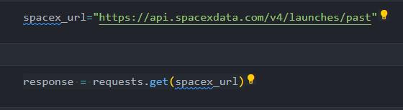
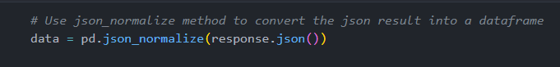
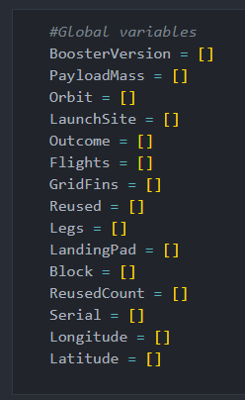
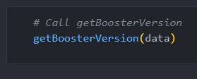
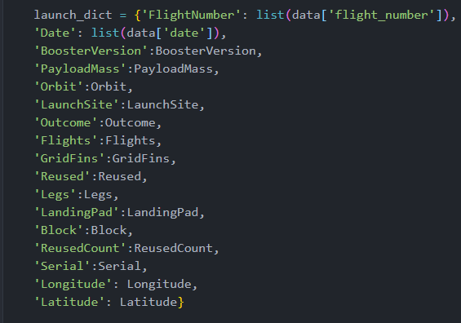
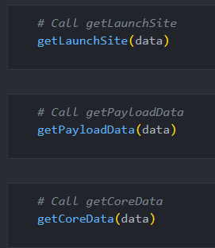
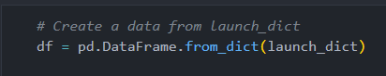
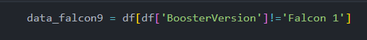
Data Collection – SpaceX REST API
Retrieving launch data using the SpaceX API, including details on the rocket used,
payload delivered, launch parameters, landing specifications, and outcome.
Create a GET response to the SpaceX REST API
Convert the response to a .json file then to a Pandas DataFrame
Use custom logic to clean the data
Define lists for data to be stored in
Call custom functions to retrieve data and fill the lists
Use these lists as values in a dictionary and construct the dataset
Create a Pandas DataFrame from the constructed dictionary dataset
Filter the DataFrame to only include Falcon 9 launches
Reset the FlightNumber column
Replace missing values of PayloadMass with the mean PayloadMass value

Slide 8
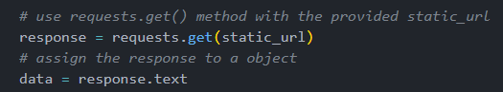
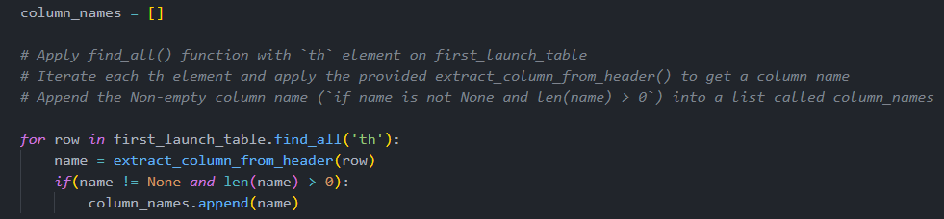
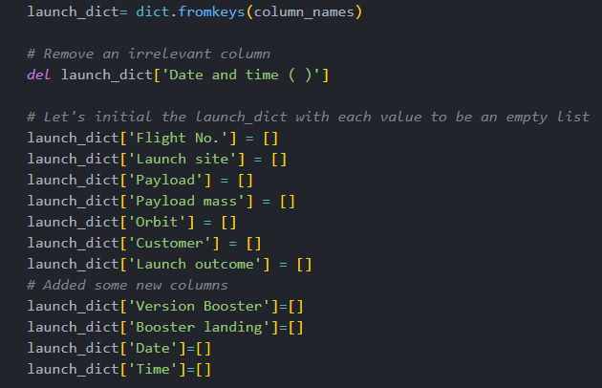
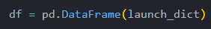
Data Collection – Web Scraping
Extracting historical Falcon 9 launch data through web scraping from the Wikipedia page titled "List of Falcon 9 and Falcon Heavy launches."
Request the HTML page from the static URL
Assign the response to an object
Create a BeautifulSoup object from the HTML response object
Find all tables within the HTML page
Collect all column header names from the tables found within the HTML page
Use the column names as keys in a dictionary
Use custom functions and logic to parse all launch tables to fill the dictionary values
Convert the dictionary to a Pandas DataFrame ready for export

Slide 9
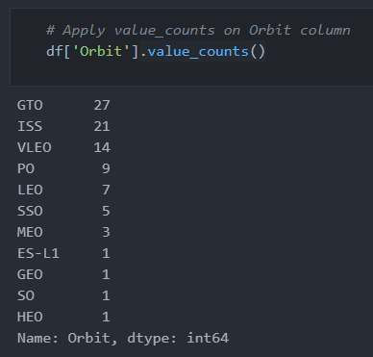
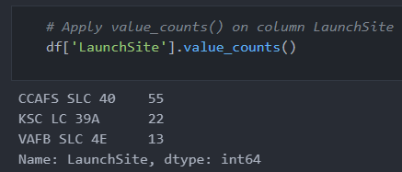
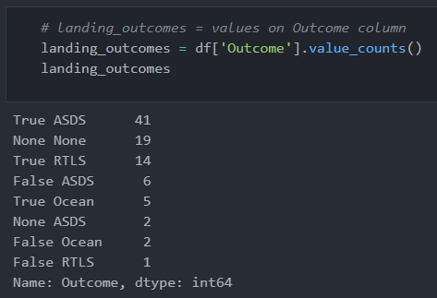
Data Wrangling
The SpaceX dataset contains information about several SpaceX launch facilities, recorded in the LaunchSite column. Each launch aims at a specific orbit, categorized in the Orbit column. The dataset also includes landing outcomes, shown in the Outcome column, which indicates whether a booster successfully landed.
Initial Data Exploration:
To analyze the dataset, the .value_counts() method is used to determine the following:
Number of launches at each site.
Number and occurrence of each orbit type.
Number and occurrence of landing outcomes per orbit type.

Slide 10
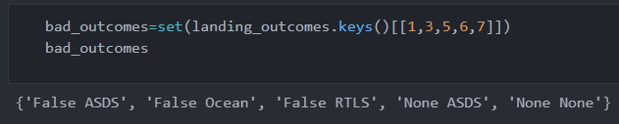
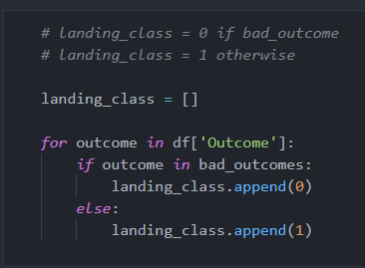
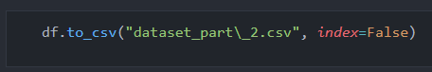
Data Wrangling:
To determine whether a booster successfully landed, a binary column is created:
1 indicates a successful landing.
0 indicates an unsuccessful landing.
Steps to Create a Binary Landing Outcome Column:
Define a set of unsuccessful outcomes (bad_outcomes).
Create a list (landing_class) with 0 if the Outcome is in bad_outcomes, otherwise 1.
Add a new Class column containing values from landing_class.
Export the DataFrame as a .csv file.

Slide 11
EDA – Visualization Methodology
To explore relationships in the dataset, various visualization techniques are applied:
Scatter Charts
Scatter plots are created to examine correlations between:
Flight Number and Launch Site
Payload and Launch Site
Orbit Type and Flight Number
Payload and Orbit Type
Purpose: Scatter charts highlight relationships between two numerical variables.
Bar Charts
A bar chart is generated to analyze the relationship between:
Success Rate and Orbit Type
Purpose: Bar charts compare numerical data across categorical variables and can be displayed either horizontally or vertically.
Line Charts
Line charts are used to observe trends over time, specifically:
Success Rate per Year (showing annual launch success trends)
Purpose: Line charts help visualize changes in numerical values over time.

Slide 12
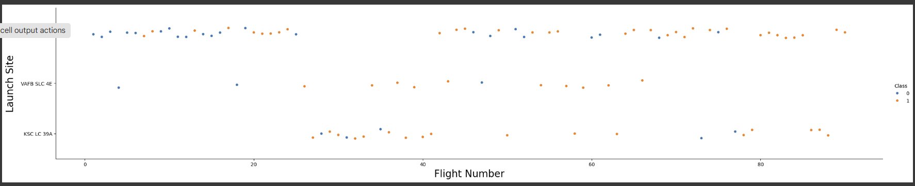
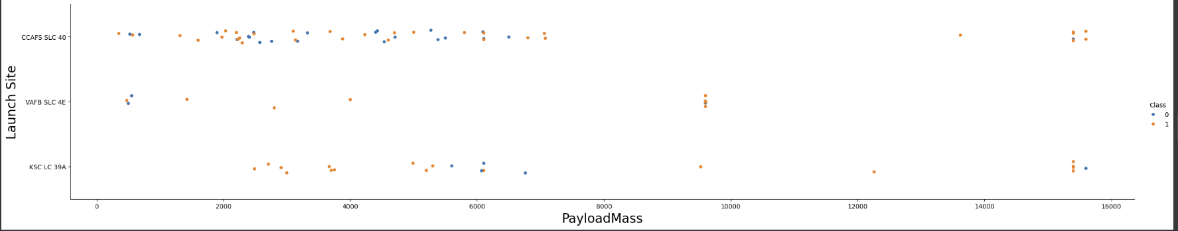
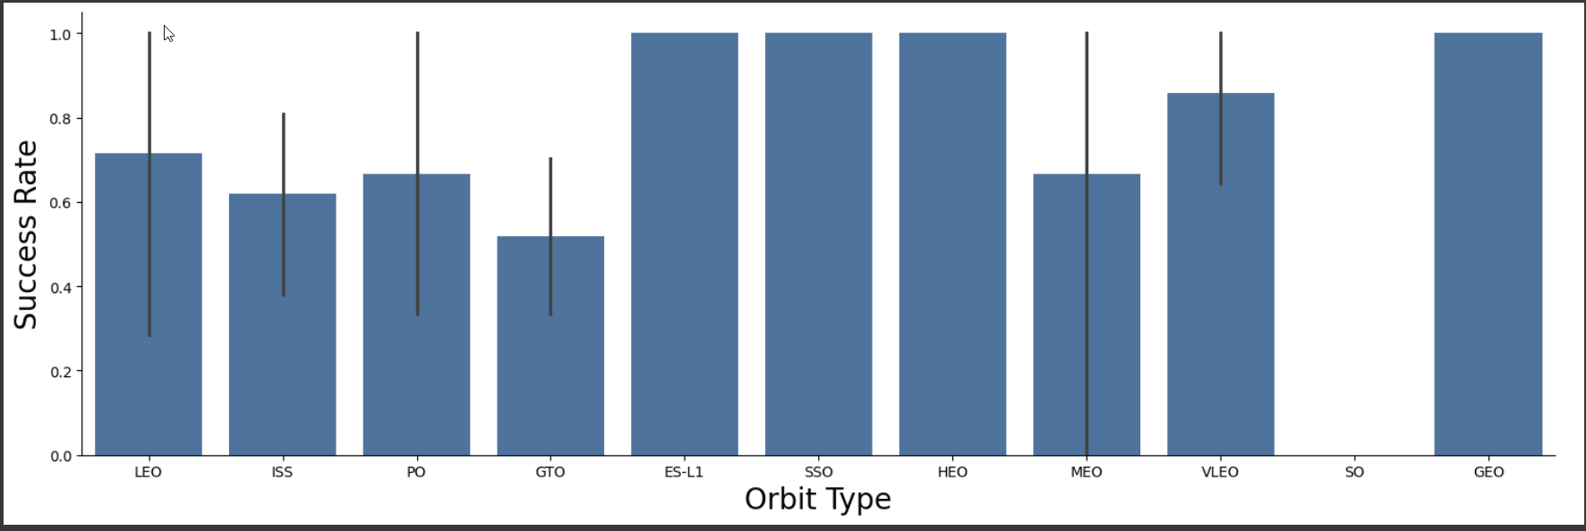
EDA – Visualization Results
The scatter plot of Launch Site vs. Flight Number shows:
Higher Flights, Higher Success – More flights lead to better success rates.
Early Failures at CCAFS & VAFB – Flights below 30 had more failures.
KSC LC 39A Had Better Success – No early launches, higher success rate.
Success Improves After 30 – Flights above 30 had more successful landings.
The scatter plot of Launch Site vs. Payload Mass highlights the following findings:
For payloads exceeding 7000 kg, unsuccessful landings are rare, though there is limited data available for these heavier launches.
No distinct correlation exists between payload mass and landing success rate at any specific launch site.
All launch sites handled a range of payload masses, with CCAFS SLC 40 primarily launching lighter payloads, though a few outliers exist.
The bar chart of Success Rate vs. Orbit Type indicates the following:
The orbits with a 100% success rate include:
ES-L1 (Earth-Sun First Lagrangian Point)
GEO (Geostationary Orbit)
HEO (High Earth Orbit)
SSO (Sun-synchronous Orbit)
The orbit with the lowest success rate (0%) is:
SO (Heliocentric Orbit)

Slide 13
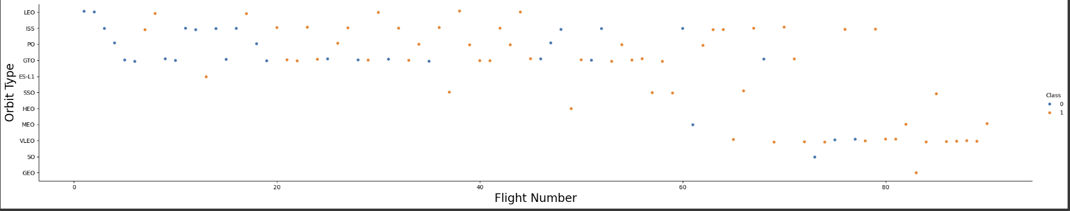
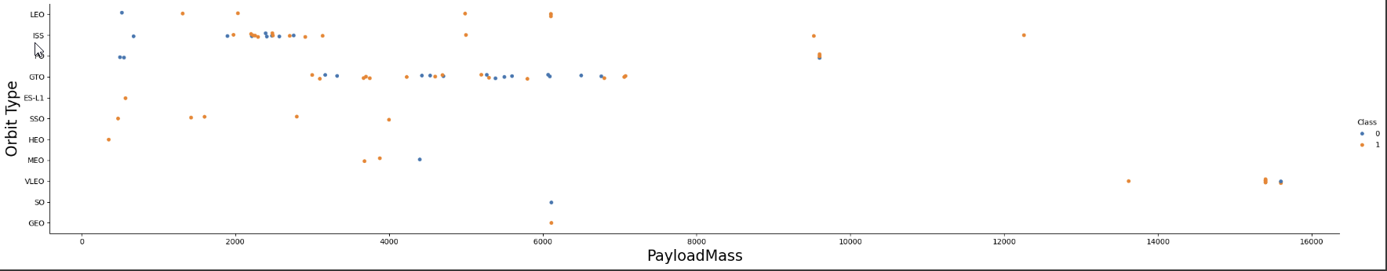
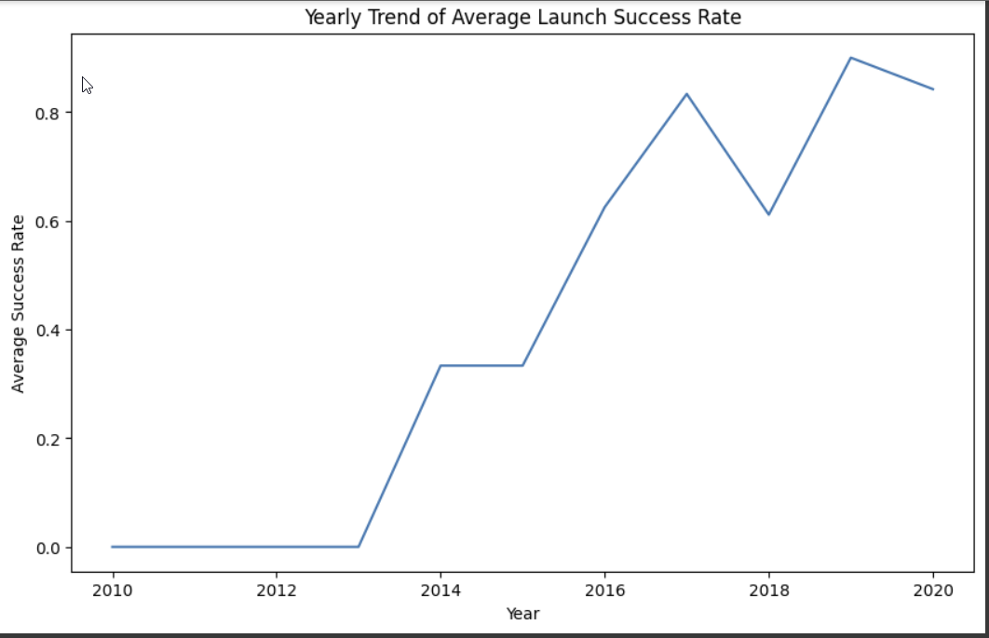
EDA – Visualization Results
Orbit Type vs. Flight Number
100% success in GEO, HEO, and ES-L1 due to single flights.
SSO shows reliable success with five successful flights.
GTO shows no clear trend between flight number and success.
Higher flight numbers improve success, especially for LEO.
Orbit Type vs. Payload Mass
PO, ISS, and LEO succeed with heavier payloads.
GTO shows no clear link between payload mass and success.
VLEO launches are typically for heavier payloads.
Yearly Success Rate Trend
2010-2013: No successful landings.
Post-2013: Steady increase with dips in 2018 and 2020.
After 2016: Success rate consistently above 50%.

Slide 14
EDA – SQL
SQL Queries on the Dataset:
Retrieve unique launch site names from space missions.
Fetch 5 records where launch sites start with 'CCA’.
Calculate the total payload mass from NASA (CRS) booster launches.
Compute the average payload mass for booster version F9 v1.1.Identify the date of the first successful ground pad landing.
List boosters with successful drone ship landings and payloads between 4000-6000 kg.
Count the total successful and failed missions.
Find booster versions that carried the highest payload mass.
List failed drone ship landings with booster versions and launch sites for 2015.
Rank landing outcomes (Failure/Success) between 2010-06-04 and 2017-03-20 in descending order.

Slide 15
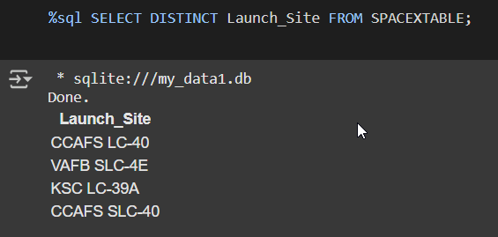
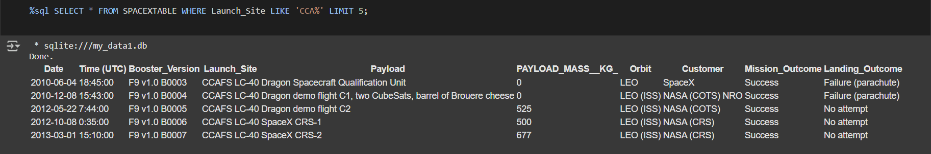
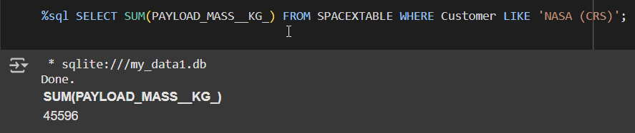
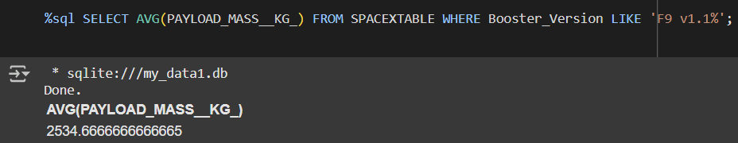
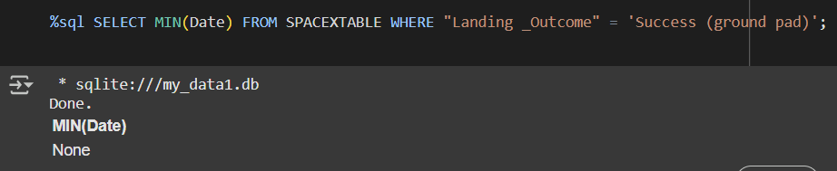
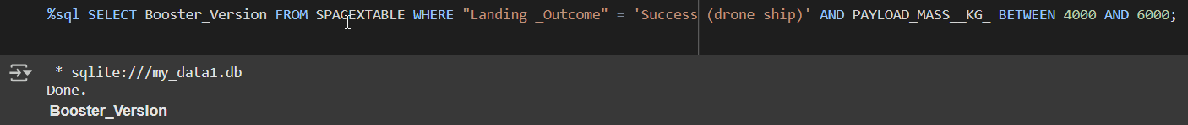
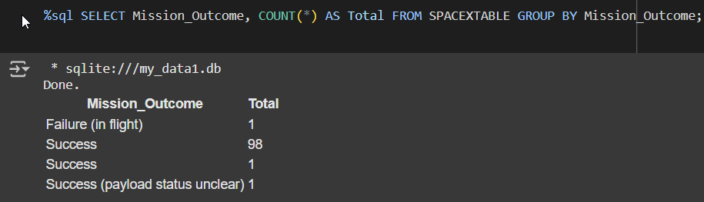
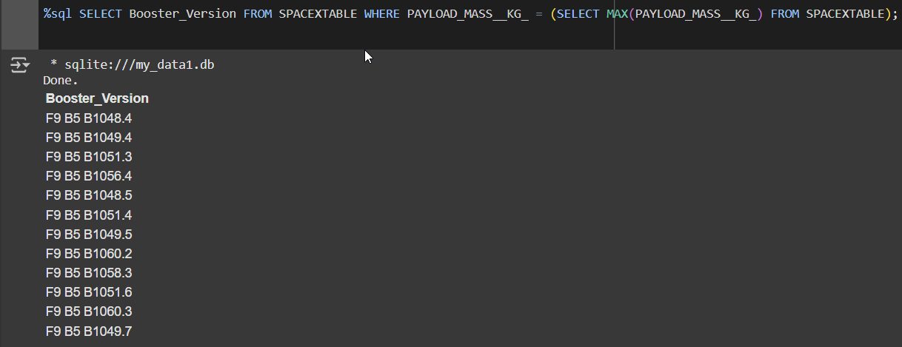
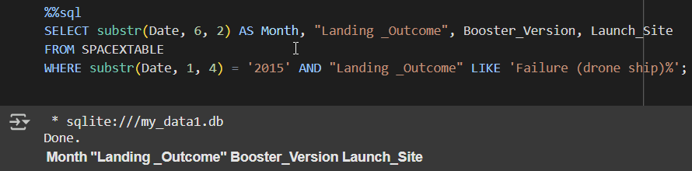
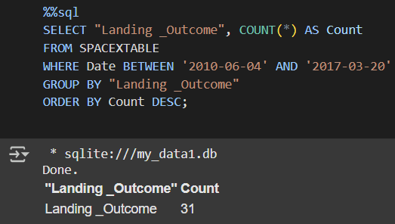
EDA – SQL Results
1
2
3
4
5
6
7
8
9
10

Slide 16
Geospatial Analysis - Folium
Mapping Launch Sites and Analysis
Mark Launch Sites
Initialize a Folium Map.
Add folium.
Circle and folium. Marker for each site.
Mark Success/Failure of Launches
Cluster launches with the same coordinates.
Use green for success (class = 1) and red for failure (class = 0).Add folium.
Marker to a MarkerCluster() and set icon_color accordingly.
Calculate Distances
Use Lat/Long values to compute distances.
Mark points with folium.Marker and connect them using folium.PolyLine.

Slide 17









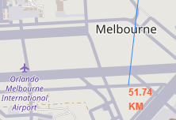
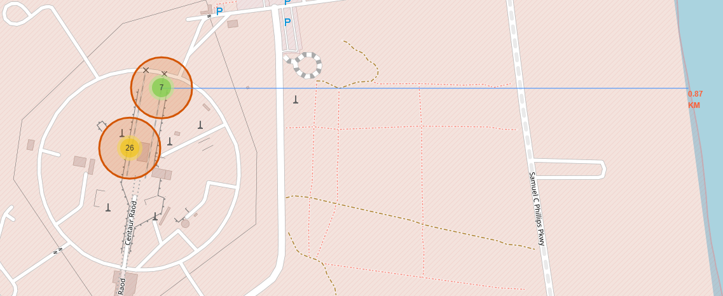
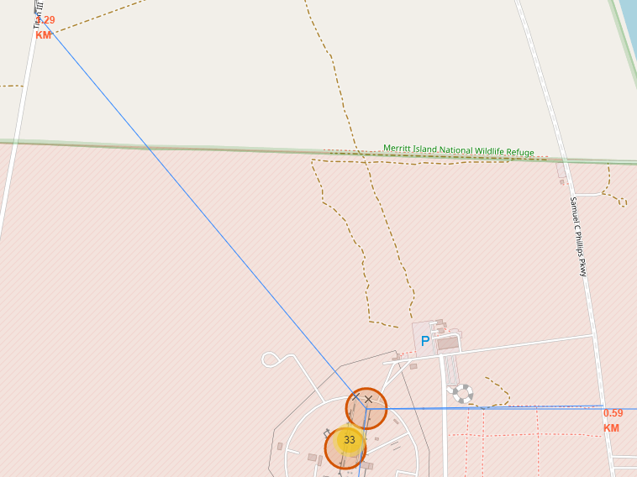

Folium - Results
CCAFS SLC-40 and CCAFS LC-40
VAFB SLC-4E
KSC LC-39A
$$=$$

Slide 18



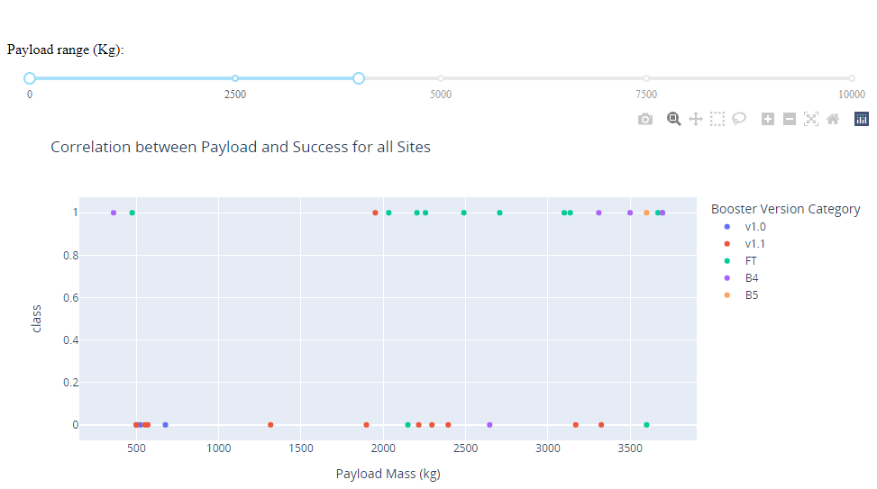
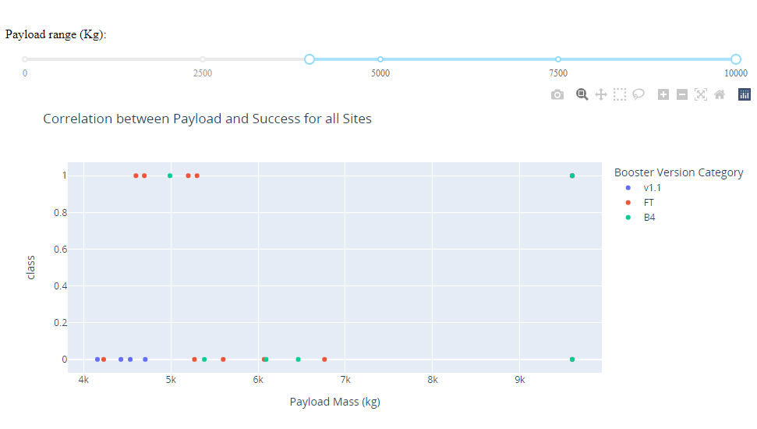
Plotly Dash Dashboard
Plotly Dash Visualizations
Pie Chart (px.pie())
Shows total successful launches per site.
Can be filtered with dcc.Dropdown() to view success/failure ratios.
Scatter Plot (px.scatter())
Displays correlation between success and payload mass (kg).
Can be filtered by payload range (RangeSlider()) and booster version.
Launch Outcome vs. Payload
Data is split into two ranges:
0–4000 kg (low payloads)
4000–10,000 kg (massive payloads)
Success rates are lower for massive payloads.
Booster types v1.0 and B5 were not used for massive payloads.

Slide 19
Predictive Analysis
Model Development
Model Evaluation
Finding the Best Classification Model
1
To prepare the dataset for model development:
Load dataset
Perform necessary data transformations (standardise and pre-process)
Split data into training and test data sets, using train_test_split()
Decide which type of machine learning algorithms are most appropriate
For each chosen algorithm:
Create a GridSearchCV object and a dictionary of parameters
Fit the object to the parameters
Use the training data set to train the model
For each chosen algorithm:
Using the output GridSearchCV object:
Check the tuned hyperparameters (best_params_)
Check the accuracy (score and best_score_)
Plot and examine the Confusion Matrix
Review the accuracy scores for all chosen algorithms
The model with the highest accuracy score is determined as the best performing model

Slide 20
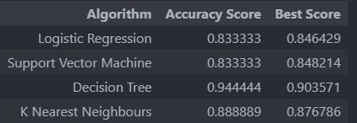
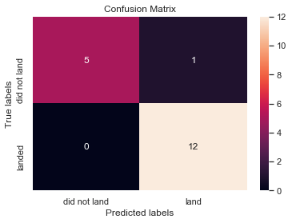
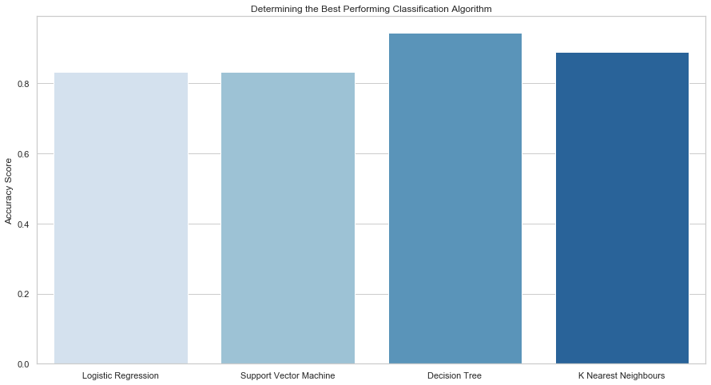
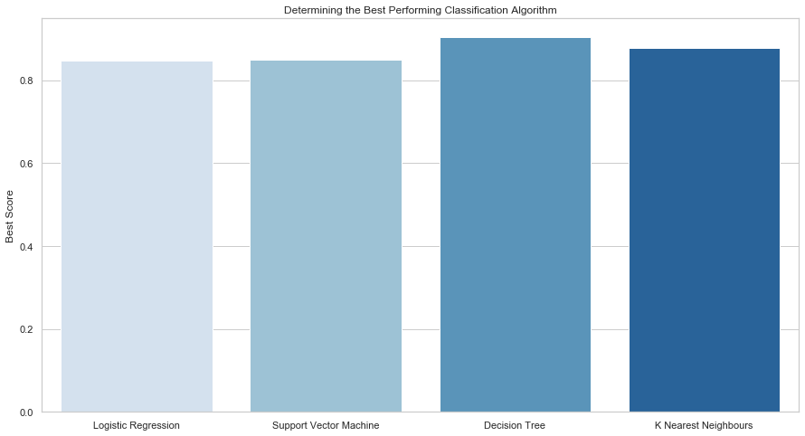
Predictive Analysis - Results
Classification Model Performance:
Decision Tree achieved the highest accuracy.
Accuracy Score: 94.44%
Best Score: 90.36%
Decision Tree Model Performance:
Best performing model with 94.44% accuracy.
Confusion matrix: 1 misclassification (false positive) out of 18 results.
Correct classifications: 5 did not land, 12 successfully landed.

Slide 21
Conclusions
Key Insights from Launch Data
Success Rate Over Time
2010-2013: No successful landings.
Post-2013: Success rate improved, with minor dips in 2018 and 2020.
After 2016: Success rate consistently above 50%.
Orbit Success Rates
ES-L1, GEO, HEO, and SSO: 100% success rate.
SSO's success is notable with 5 successful flights.
PO, ISS, and LEO: More success with heavy payloads.
VLEO launches are associated with heavier payloads.
Top Launch Site
KSC LC-39A: Most successful site, 41.7% of total successes with a 76.9% success rate.
Payload Success
Massive payloads (>4000kg) have lower success rates than lighter ones.
Best Classification Model
Decision Tree Model had the highest accuracy at 94.44%.

Slide 22
Thank you

